Slide 1


Comparison of reservoir routines for large-scale hydrological models
Jesús Casado Rodríguez, Juliana Disperati, Stefania Grimaldi, Peter Salamon

Slide 2

Introduction
In the preparation for the new release of GloFAS (Global Flood Awareness System), we wanted to improve the reservoir representation:
Number of reservoirs
Reservoir routine
Reservoir calibration
Currently
Source: GLWD
No records
Outflow is a linear function of storage
Calibration using streamflow together with other model parameters
Questions
What’s the most suitable model?
What’s the most relevant variable to be calibrated?
Challenges
Lack of observations
The routine must be applicable worldwide

Slide 3
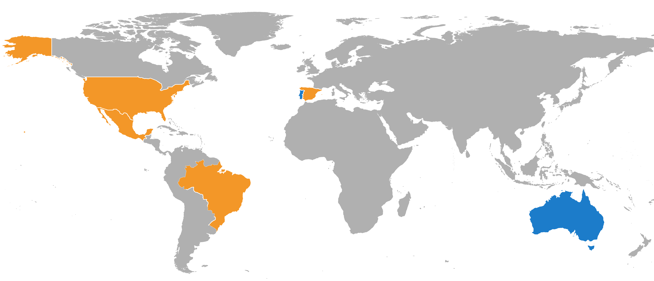
Data
Observed reservoir operations to be used in process-based or data-driven models
Daily time series
Reservoir
Inflow (observed/simulated)
Outflow
Storage
Meteorology (ERA5/EMO1)
Precipitation
Temperature
Evaporation
Static attributes
Reservoir characteristics (GRanD/GDW)
Catchment characteristics (GloFAS/EFAS)
ResOpsUS
Steyaert et al. (2022)
ResOpsES
CEDEX
ResOpsMX
CONAGUA
ResOpsBR
ANA
* Available in nahaUsers/casadje/datasets/reservoirs/

Slide 4
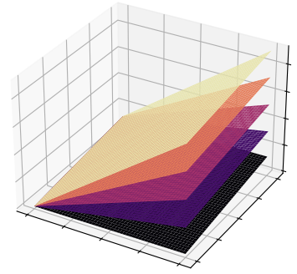


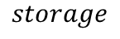
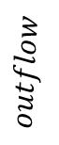



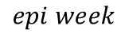
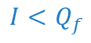
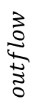
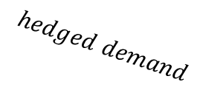
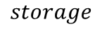
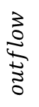

Reservoir routines
OS-LISFLOOD
Burek (2013)
CaMa-Flood
Hanazaki (2022)
mHM
Shrestha (2024)
starfit
Turner (2021)
$$I<Q_{f}$$
$$I≥Q_{f}$$
$$storage$$
$$outflow$$
$$outflow$$
$$outflow$$
$$storage$$
$$outflow$$
$$inflow$$
$$hedged demand$$
$$storage$$
$$storage$$
$$epi week$$
Only uses storage
No seasonality
Data-minimal
2 parameters
Uses storage & inflow
No seasonality
Data-minimal
No parameters
Uses demand & inflow & storage
Demand hedging induces seasonality
5 parameters
Observed seasonality
Data-intense
19 parameters
github.com/casadoj/lisflood-reservoirs

Slide 5
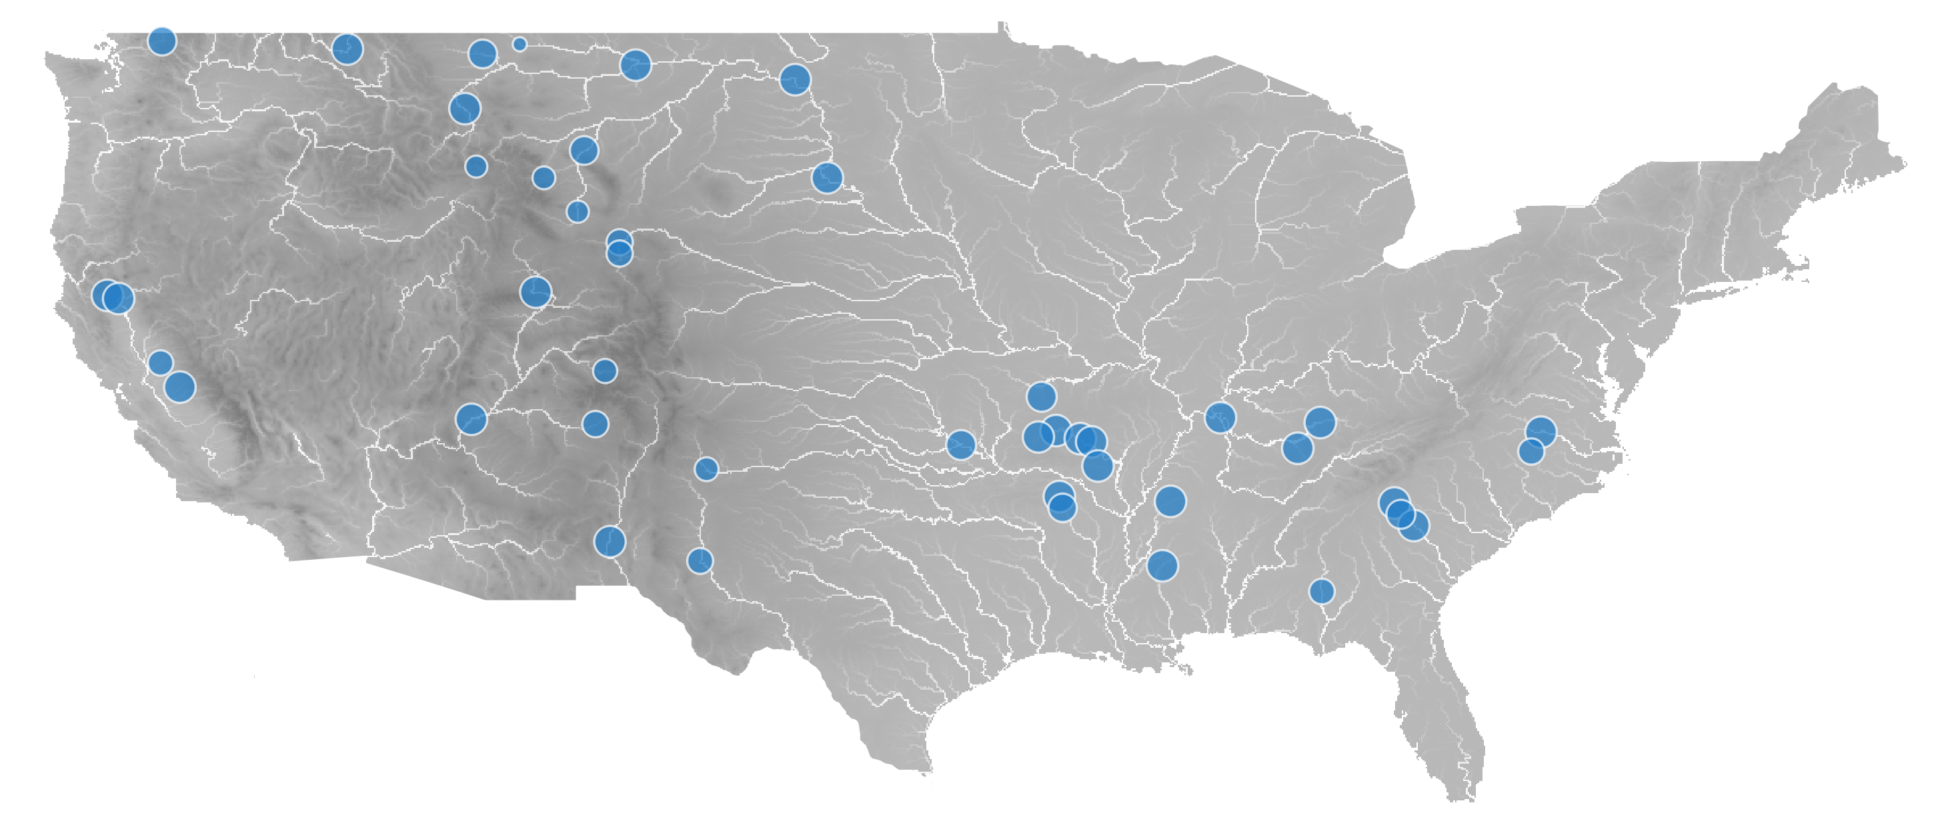
Experiment
calibrate
storage
(SCEUA-S)
Comparison of the performance of the reservoir routines in 123 reservoirs in the US:
Observed inflow, storage and outflow
At least 4 years of observations
Catchment ≥ 250 km²
Capacity ≥ 10 hm³
Degree of regulation ≥ 1 month
runs
default
calibrate
outflow
(SCEUA-Q)
calibrate
storage & outflow
(SCEUA-QS)
* target metric: modified KGE
** parameters: LISFLOOD (6), CaMa-Flood (5), mHM (5)
*** starfit was fitted, instead of calibrated with SCEUA
Notes:
To give the LISFLOOD routine maximum flexibility, I defined 6 calibration parameters. In this way, the maximum potential of the routine can be compared with highly parameterized routines like mHM or Starfit.
The CaMa-Flood model does not have calibration parameters in the original definition. However, to be able to fit the model and give as much flexibility as possible, I defined 5 calibration parameters.
The mHM routine has 5 parameters in the definition in Shrestha et al. (2024). However, this routine is an evolution of previous models in which many of the parameters were constants. I used those constants as the parameter values in the “default” run.
Starfit does not require an iterative calibration process like SCEUA. It fits the coefficient of the harmonic curves to the observed; to do so standard SciPy functions are used. This fitting always requires both storage and outflow time series, so the only run in which Starfit can be compared with the other routines is the bivariate calibration (SCEUA-QS).

Slide 6
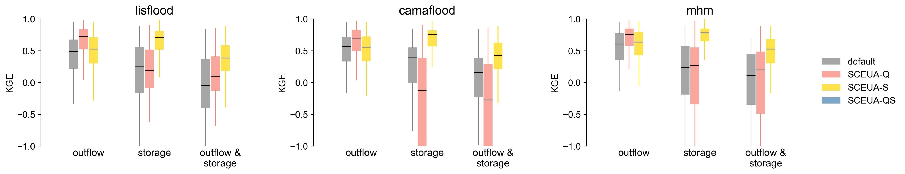
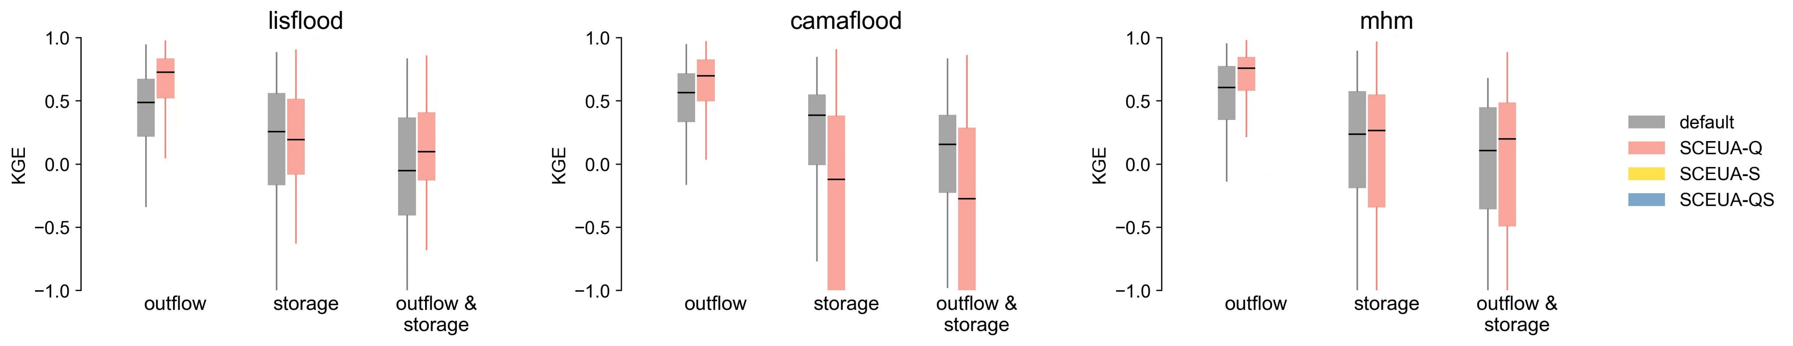
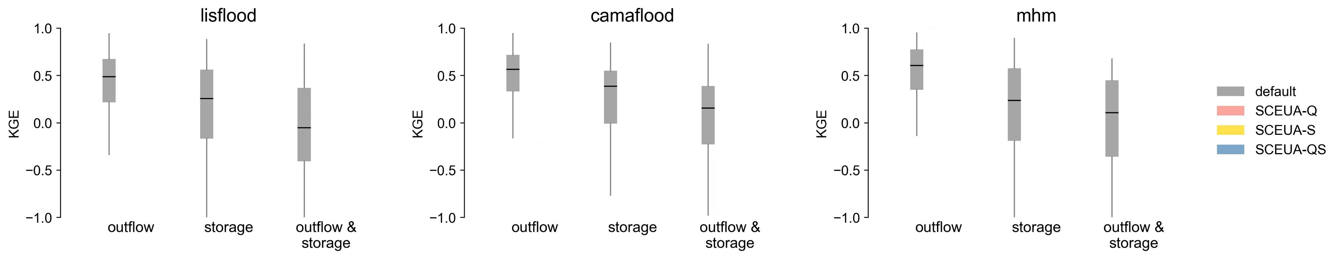
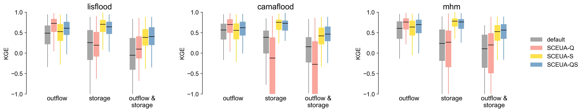
Results
What’s the most relevant variable to be calibrated?
Default parameters reproduce better outflow than storage
Calibrating outflow may deteriorate storage performance
Calibrating storage improves notably storage performance without limiting outflow performance
Storage is a variable more accessible → possible use of satellite altimetry
The bivariate calibration has an overall performance similar to the univariate calibration of storage

Slide 7
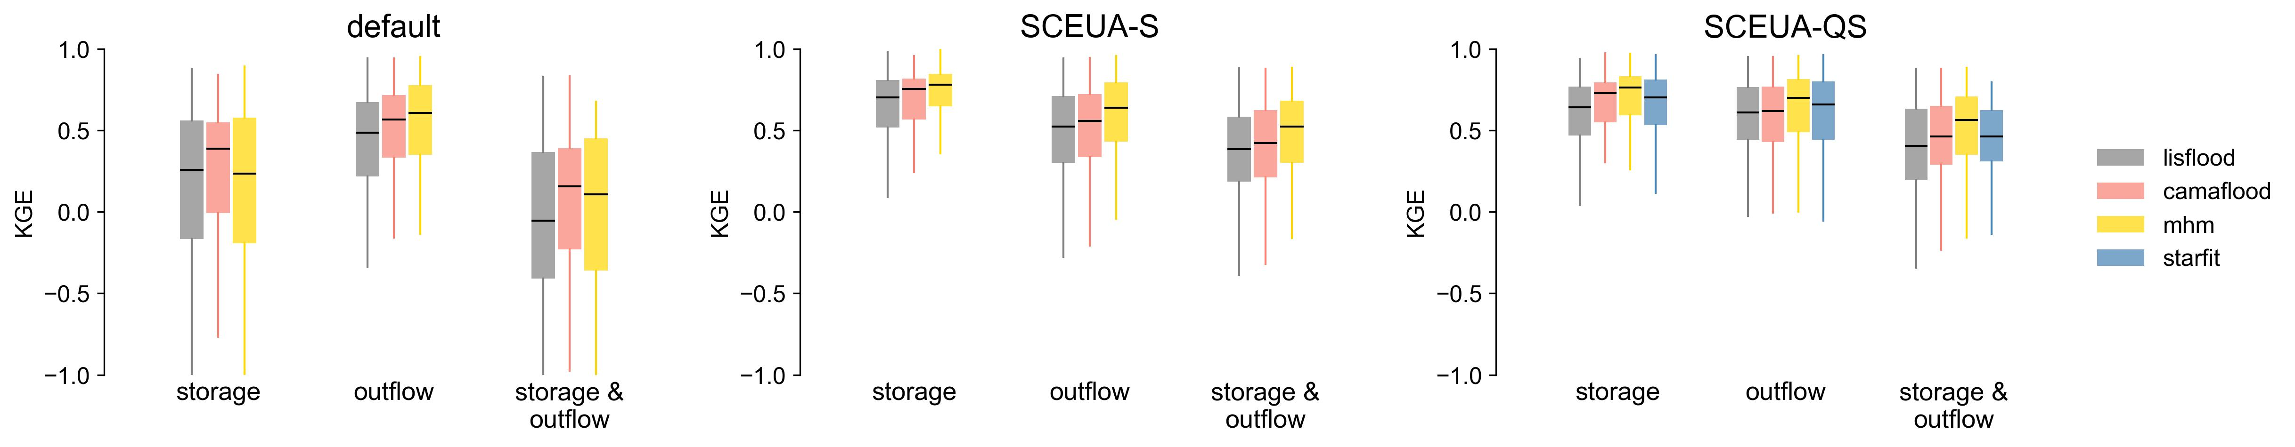
Results
What’s the most suitable routine in a large-scale model?
CaMa-Flood shows the highest performance with default parameters
Applicable in data-poor contexts
When calibrated, mHM stands as the best-performing model
Data-intense and reservoir specific → complicates global application
Starfit cannot outperform mHM despite being highly parameterized

Slide 8
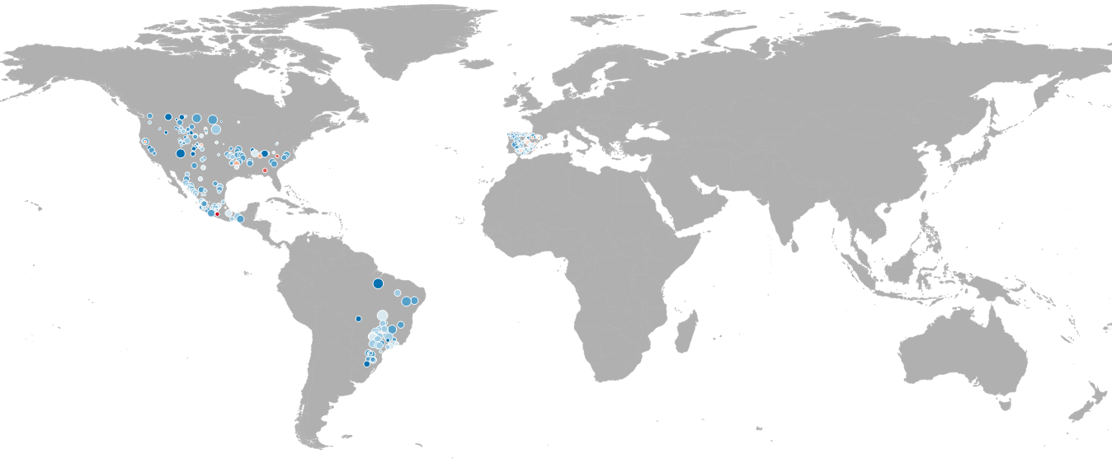
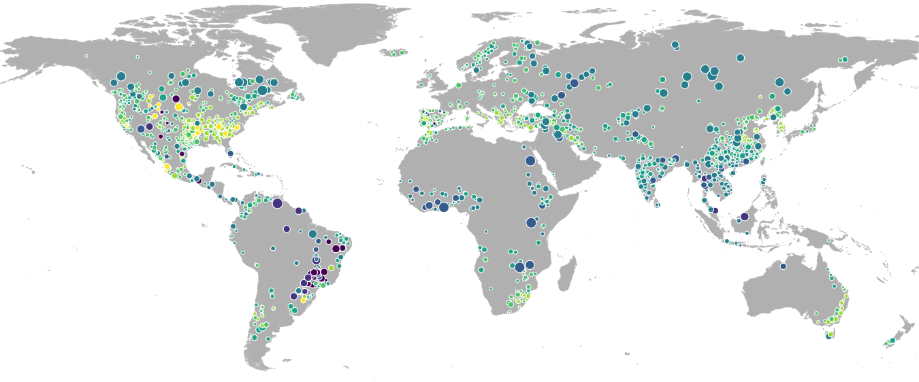
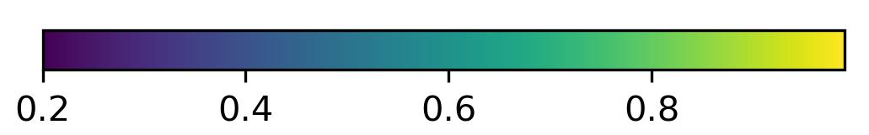
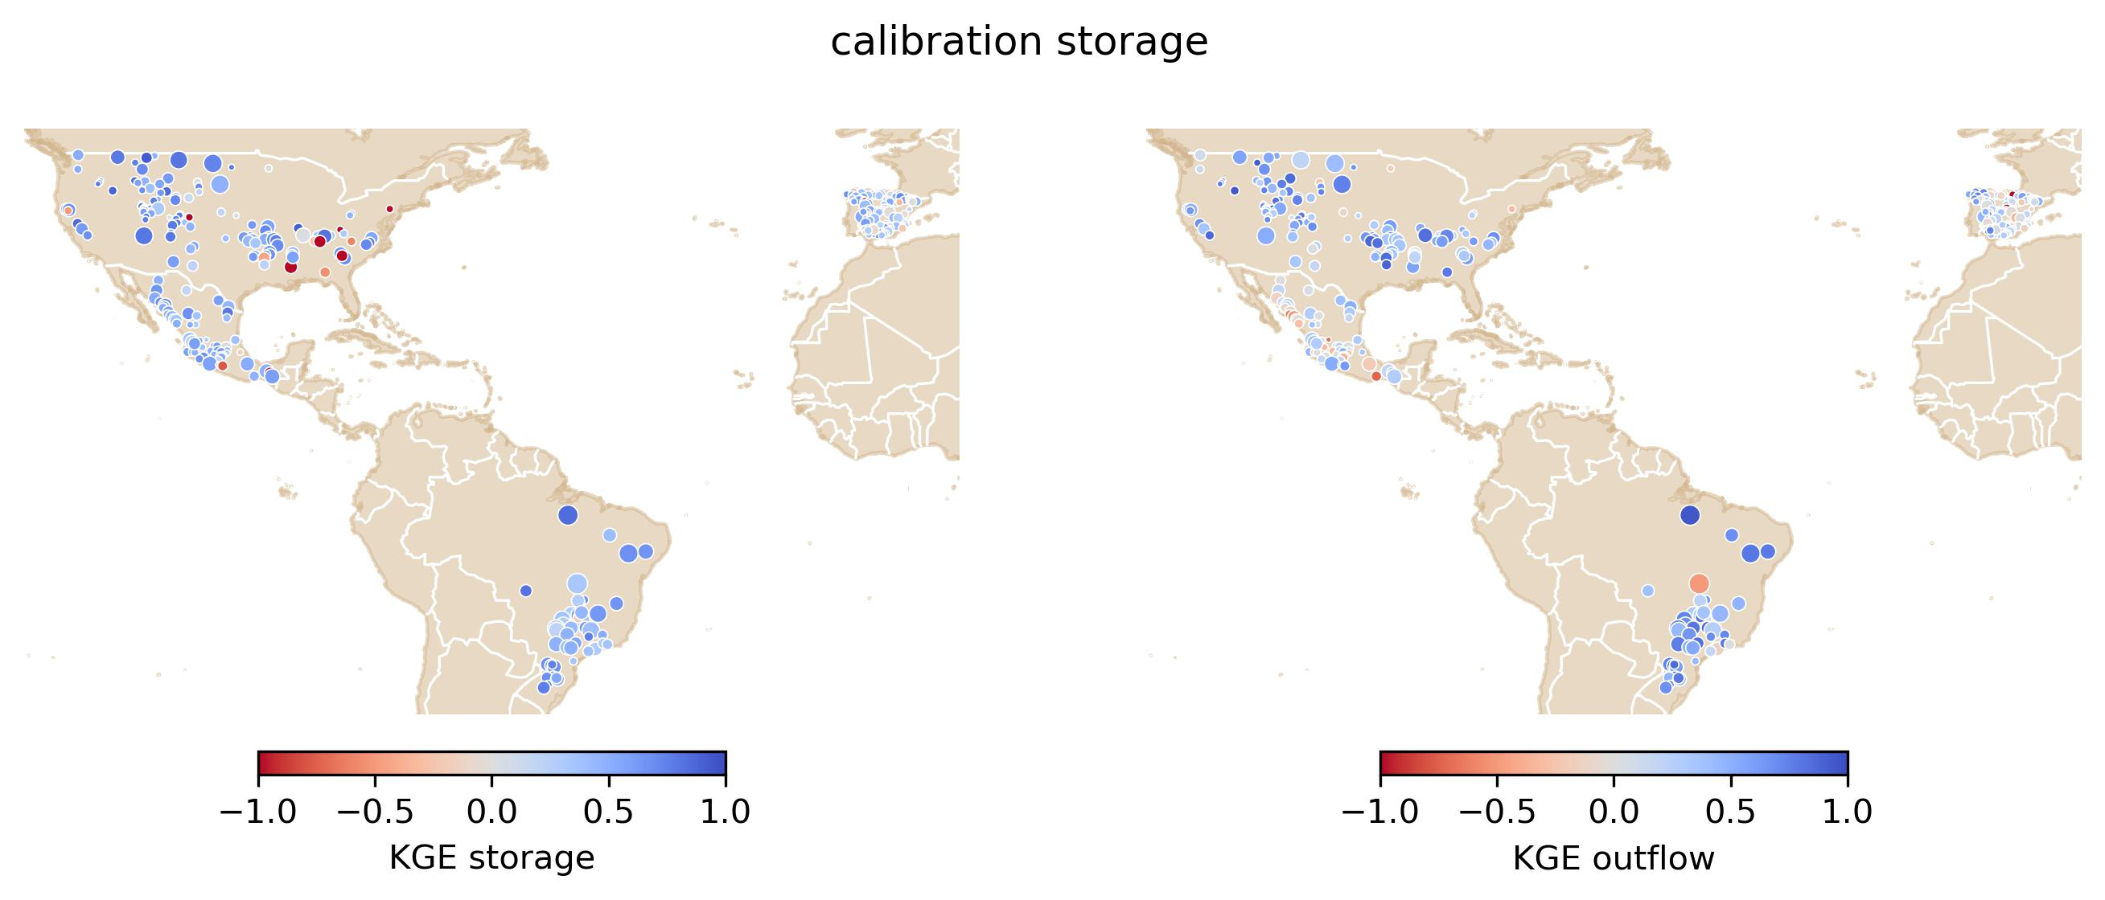
GloFAS5
Implement the CaMa-Flood reservoir routine in OS-LISFLOOD
Calibrate 2 parameters in that routine to reservoirs in the US (123), MX (59), BR (48), ES (130)
Fit a random forest model that estimates those parameters based on reservoir and catchment characteristics
Regionalize model parameters for 1710 reservoirs worldwide
-1.0 -0.5 0.0 0.5 1.0
KGE storage
flood storage (-)
Notes:
The reason why here I calibrated 123 reservoirs in the US, whereas in the model comparison I only had 90, is that I relaxed the condition on the number of years with data. For the model comparison I used only reservoirs with 8 years, particularly because Starfit requires more data. However, for the final calibration of the CaMa-Flood model I relaxed that condition to 4 years, following the conditions used to select calibration points in GloFAS.

Slide 9
Conclusions
What we did
Create datasets of observed reservoir operations
Compare reservoir routines in a data-rich context
Implement the most feasible routine in a data-scarce context
For the future
Expand the datasets: PT, AU
Explore the applicability of satellite altimetry: historical and operational
Explore data-driven models

Slide 10

Thank you
© European Union 2023
Unless otherwise noted the reuse of this presentation is authorised under the CC BY 4.0 license. For any use or reproduction of elements that are not owned by the EU, permission may need to be sought directly from the respective right holders.

Slide 11
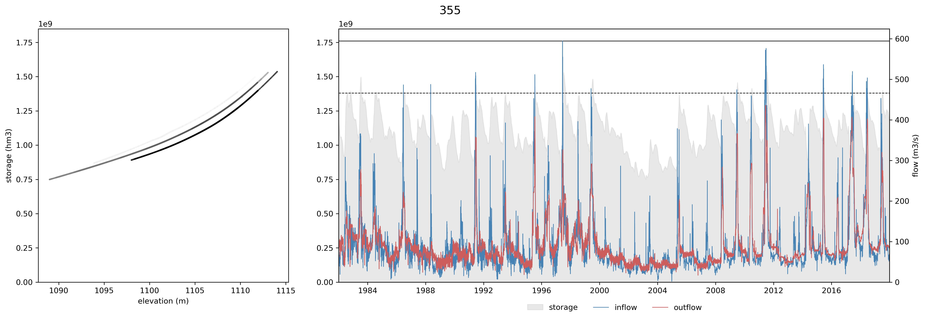
Reservoir routines
355 - Yellowtail

Slide 12
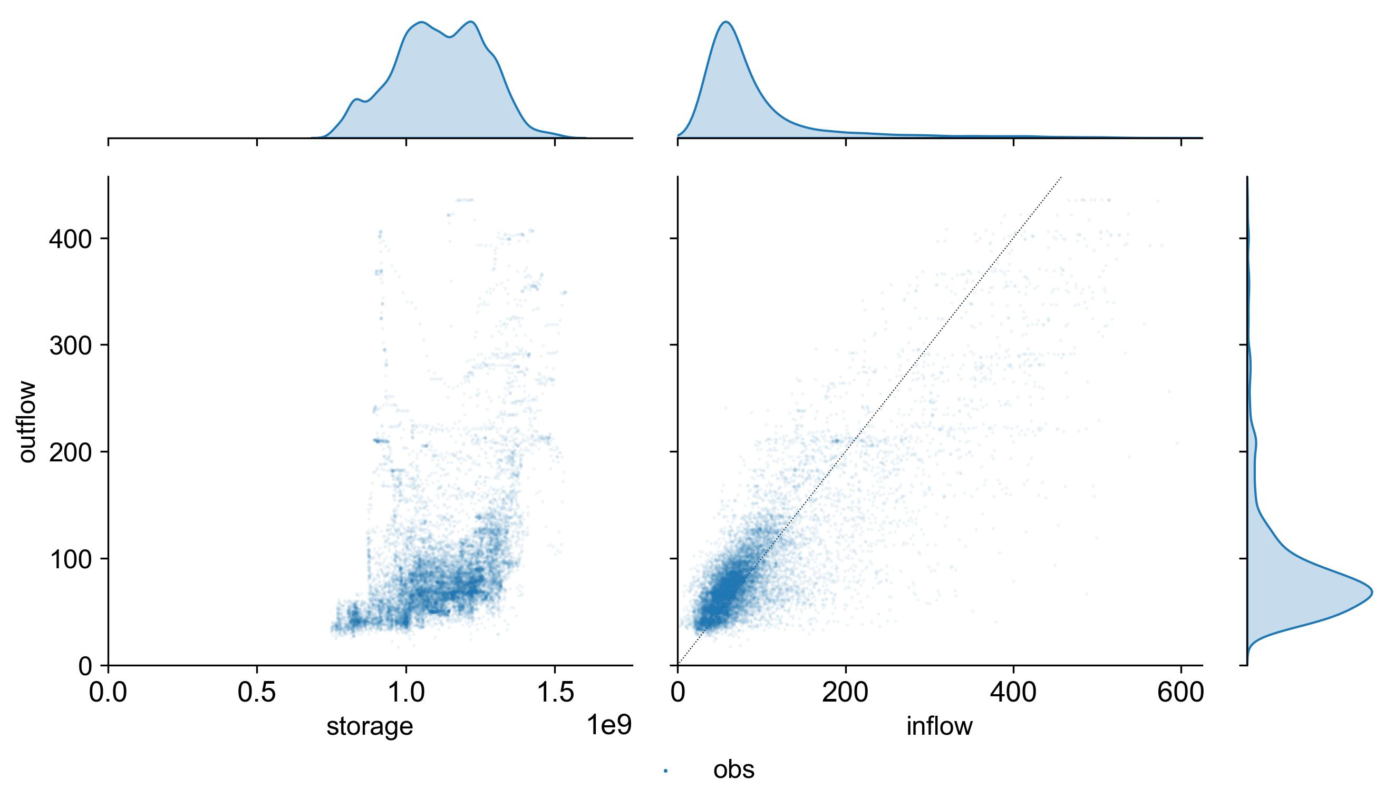
Reservoir routines
355 - Yellowtail

Slide 13
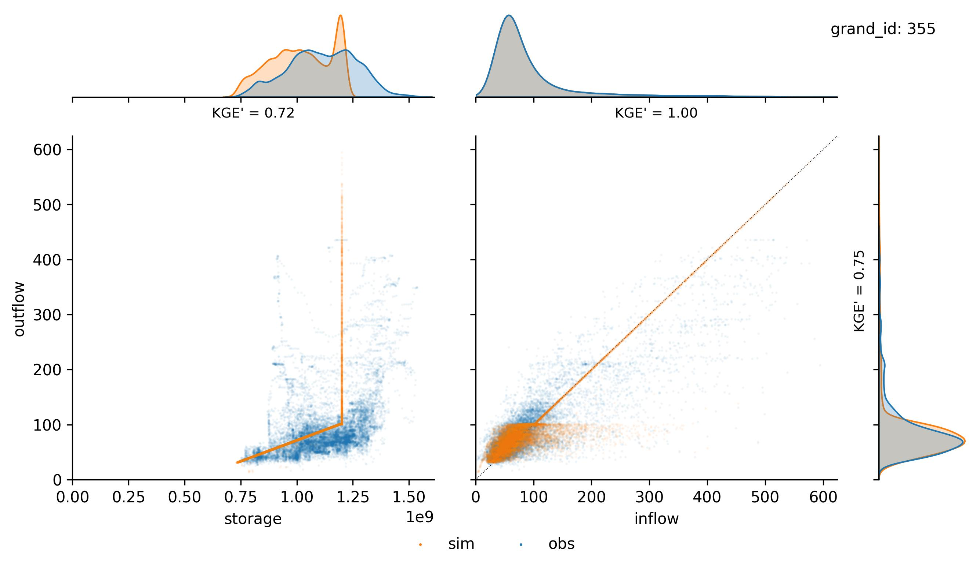
Reservoir routines
355 - Yellowtail
LISFLOOD

Slide 14
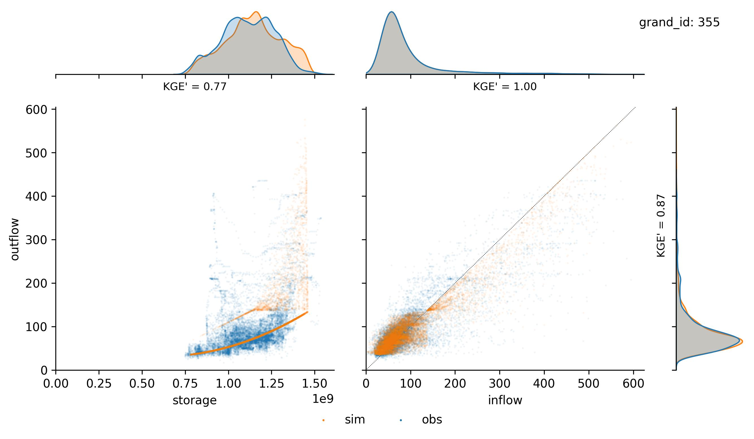
Reservoir routines
355 - Yellowtail
CaMa-Flood

Slide 15
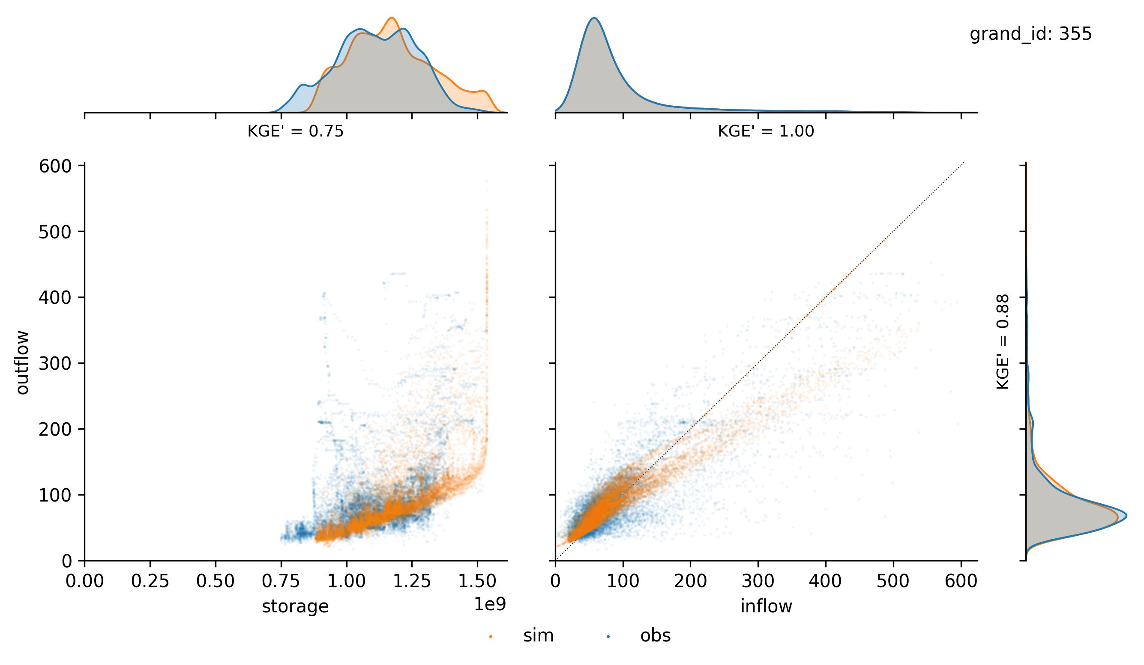
Reservoir routines
355 - Yellowtail
mHM

Slide 16
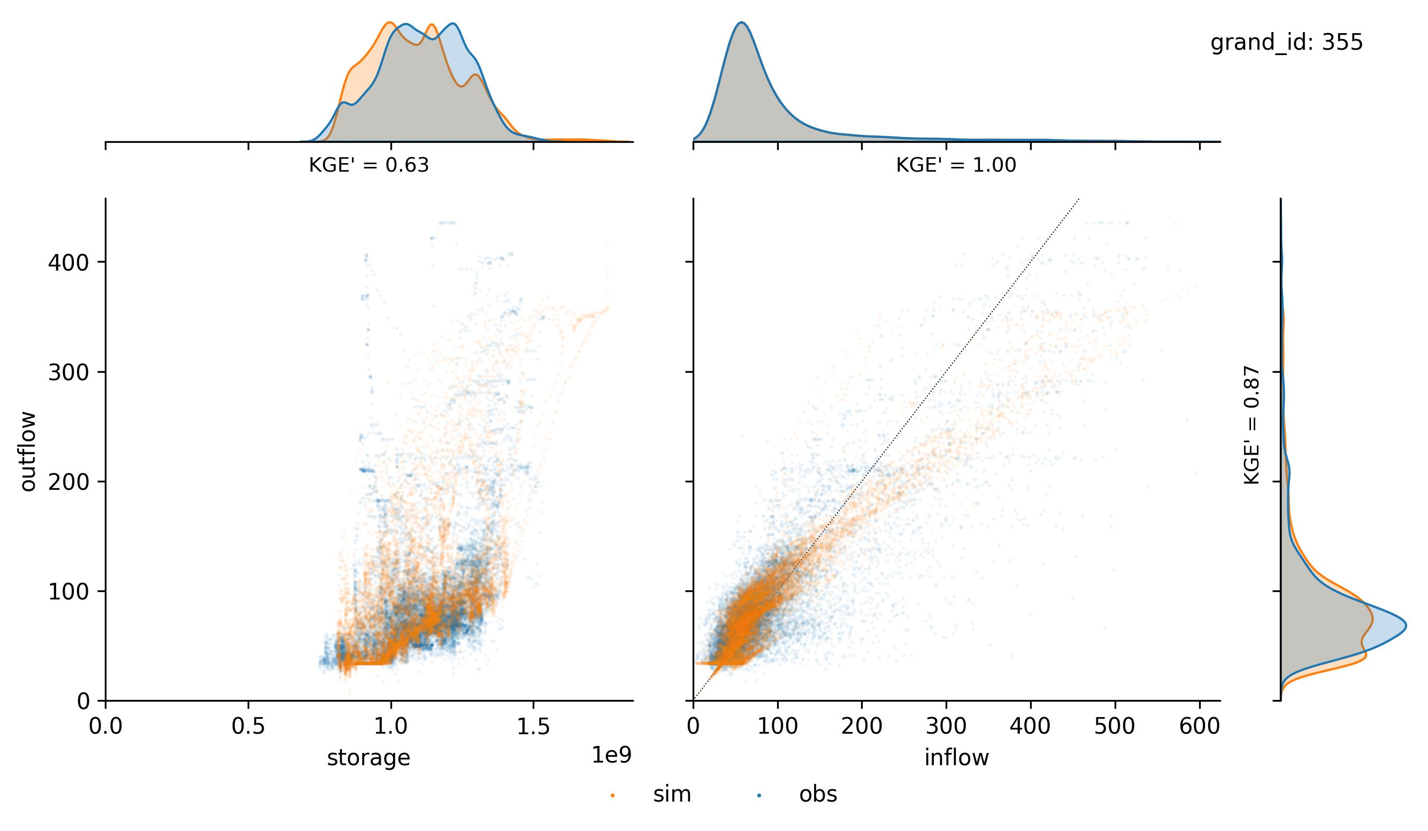
Reservoir routines
355 - Yellowtail
Starfit

Slide 17
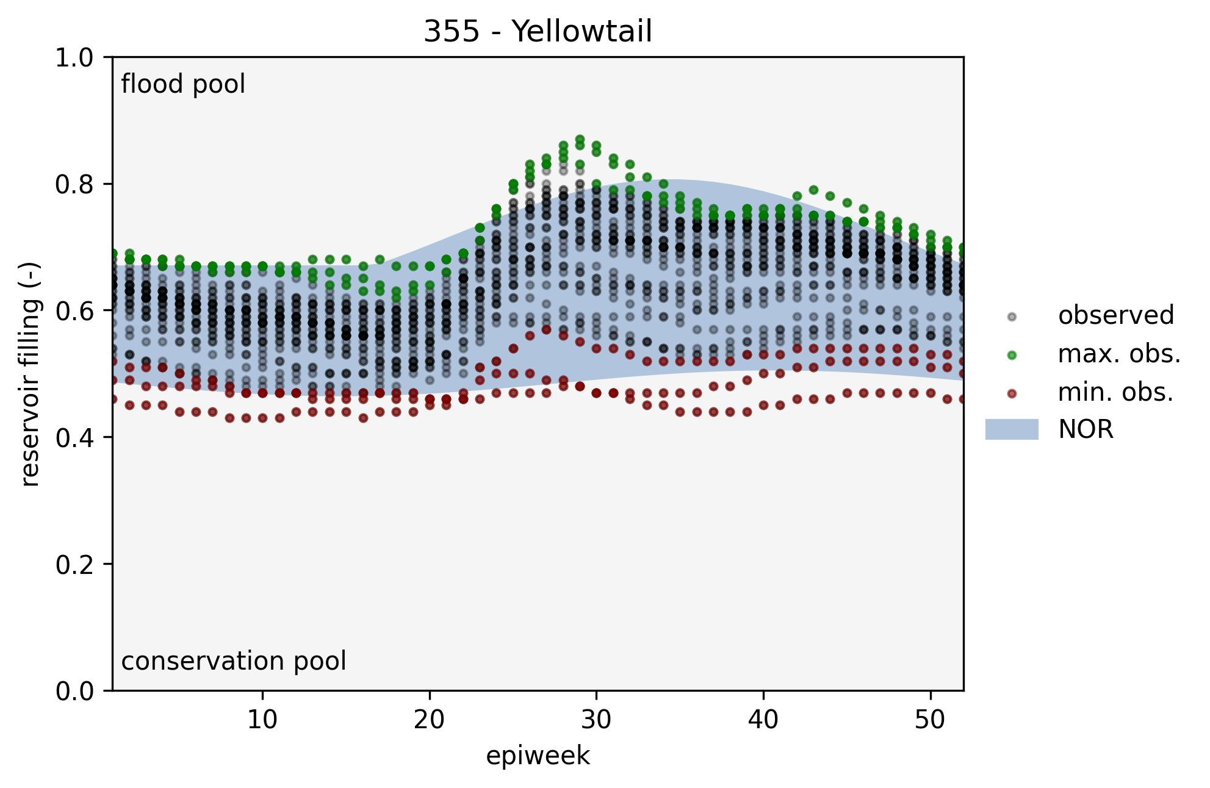
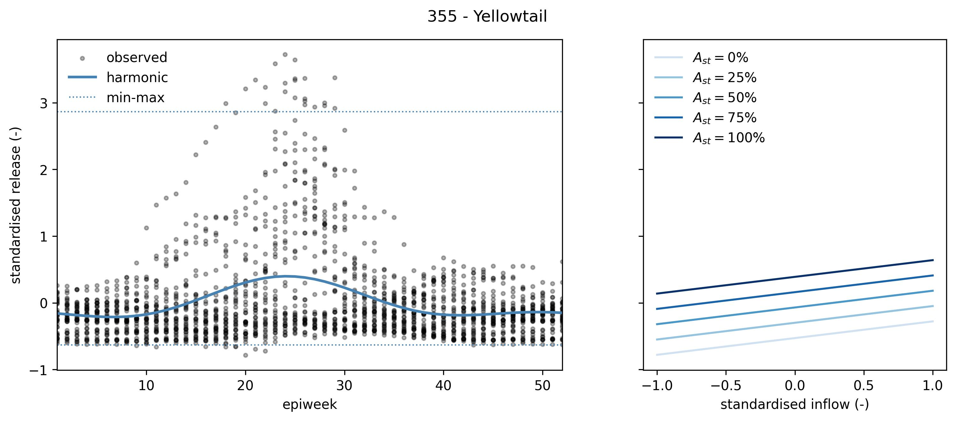
Reservoir routines
355 - Yellowtail
Starfit

